Slide 1
Movie Recommender System:-
25/12/21

Slide 2
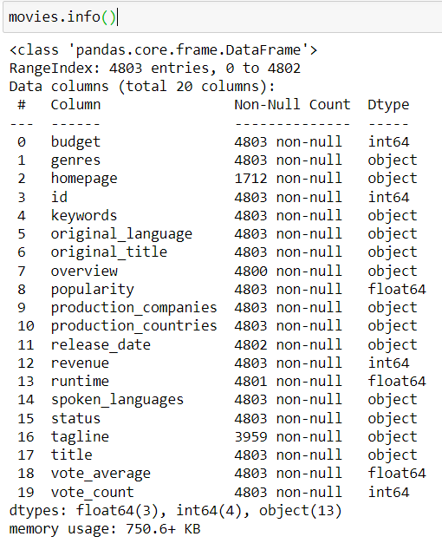
Overview:-
Problem statement
Dataset downloading and extraction
Exploratory data analysis
Data pre-processing
Model building [Bag of words]
conclusion

Slide 3
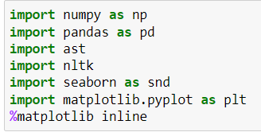
Libraries used :-
Numpy – Makes working with array dataframes easy.
Pandas – It is used to interpret the dataset and to make necessary modifications in the data.
Nltk –To avoid reiteration of similar words.

Slide 4
Problem Statement :-
We were provided with a dataset of various movies, based on which
the movie recommender was to be implemented. The idea was to perform a Count vactorization using the sklearn module and then finding the cosine distance between each movie vector.

Slide 5
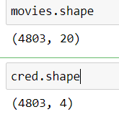


About the dataset:-
It contains a vast amount of data regarding 4500+ movies.
There were two datasets provided to use 'Movies' and 'Credits' datasets
We merged the two datasets on the basis of the 'Title' of the movie.

Slide 6
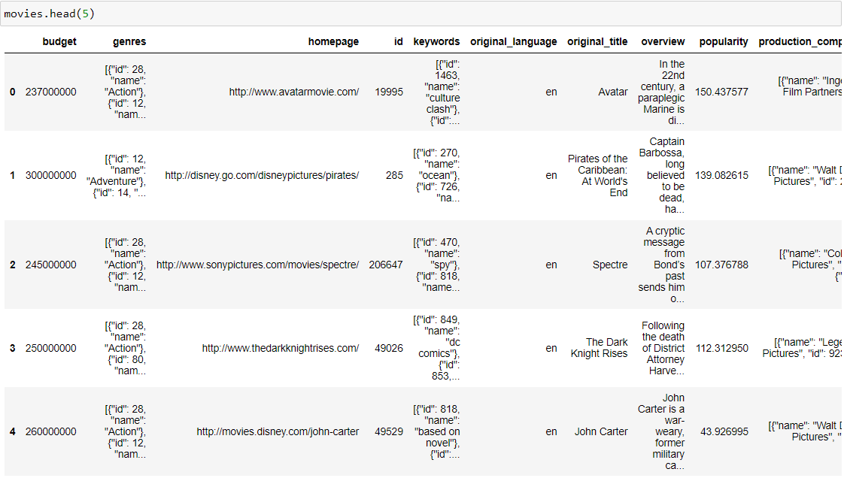

Slide 7
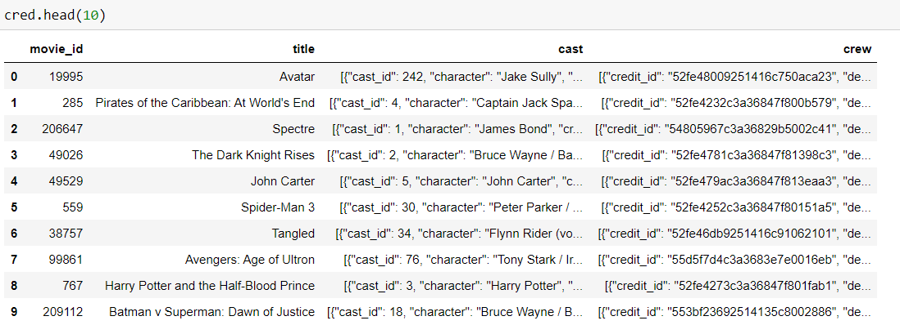

Slide 8

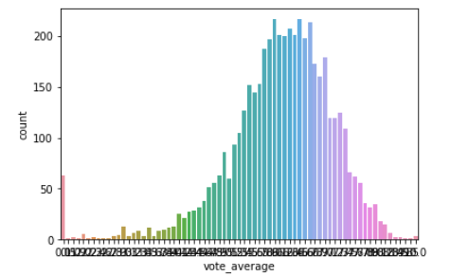
Exploratory data analysis:-
There were about 20 columns in movies dataset and 4 columns in credit dataset.
Out of which 8 columns from movies dataset were used.
The data was checked for any null or missing values and were sorted.

Slide 9

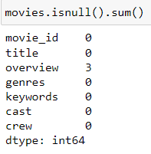
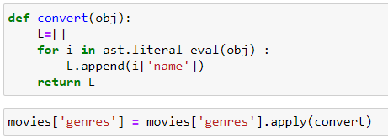
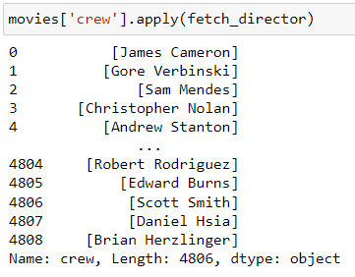

Data Pre-processing:-
The null values were eliminated as there were only a few of them.
The data was scanned for any duplicate entries.
Later on the cast and crew columns were converted into a string using 'ast' inbuilt library.

Slide 10
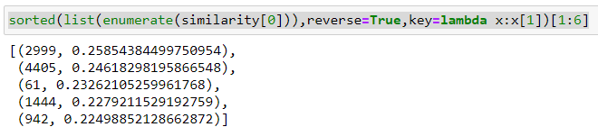
Process:-
The main objective of the project was to make a content based movie recommender .
The data in the cast and crew columns were converted into lower case string format .
Tags were created for all the movies by merging various columns .
Tags were converted into vectors
The cosine distance between every movie was calculated.
Then the similarity score between two movies were predicted.
Top 5 movies with highest similarity scores were recommended.

Slide 11
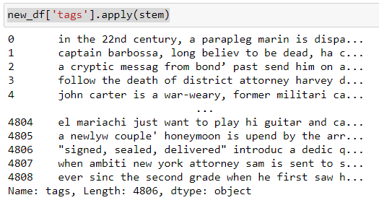
Conclusion:-
The tags were successfully converted into vector format using the ast library.
The cosine distance between the vectors was calculated using the nltk library.
The similarity scores were predicted based on the cosine distance of the movies.
The movies with highest similarity scores were recommended.

Slide 12
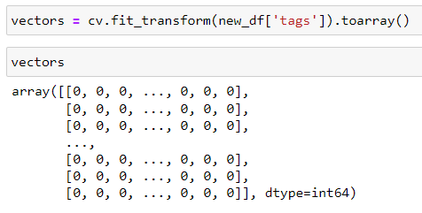
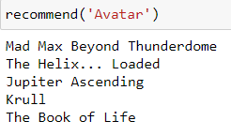
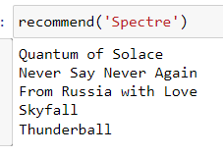
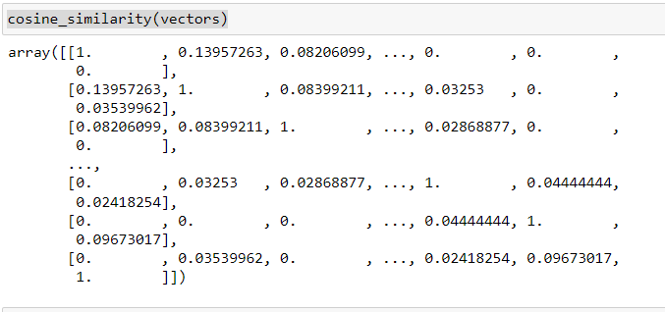
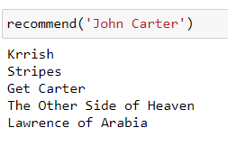

Slide 13
Thank You...

Slide 14
Team:-
Mohammed Mustafa Siddiq 1604-19-736-307
Mohammed Abdul Jabbar 1604-19-736-310
Mirza Abdul Wajid Baig 1604-20-737-110
Mohammed Asim Alam 1604-20-737-118

